Slide 1
Identification of Location to open a new Western Café in Kuala Lumpur, Malaysia
Client: Little Noshery, Manhattan
By: Jayaprakash Saththasivam

Slide 2
Problem Statement
Little Noshery (LN) is a famous café operating in Marble Hill, Manhattan.
LN would like to open a new branch in Kuala Lumpur
LN target customer is International community and tourist of Kuala Lumpur
Additional Request by LN:
The new location in Kuala Lumpur should have similar nearby venues like Marble Hill since LN believes that their profitable business at Marble Hill is due to favorable location.

Slide 3
Proposed Solution
Explore Marble Hill to understand the what are the nearby venue of their current location.
Identify locations in Kuala Lumpur that has similar venue categories as Marble Hill.

Slide 4
Data Description
Use Foursquare location data to identify the top ten venue categories in Marble Hill.
Identify districts in Kuala Lumpur and use Foursquare location data to identify the top ten venue categories in each district of Kuala Lumpur

Slide 5
Methodology
Obtain Marble Hill location using geopy function
Clean and analyze Marble Hill’s Foursquare Location data to find the top venue categories in Marble Hill.
Find the location of districts in Kuala Lumpur
Clean and analyze Foursquare Location data of each district in Kuala Lumpur and determine the top venue categories of each district.
Cluster the districts and finally identify a suitable cluster to open a new Little Noshery branch

Slide 6
Methodology
Obtain Marble Hill location using geopy function
Clean and analyze Marble Hill’s Foursquare Location data to find the top venue categories in Marble Hill.
Find the location of districts in Kuala Lumpur
Clean and analyze Foursquare Location data of each district in Kuala Lumpur and determine the top venue categories of each district.
Cluster the districts using K-MEANS
Finally identify a suitable cluster for the opening of a new Little Noshery branch

Slide 7
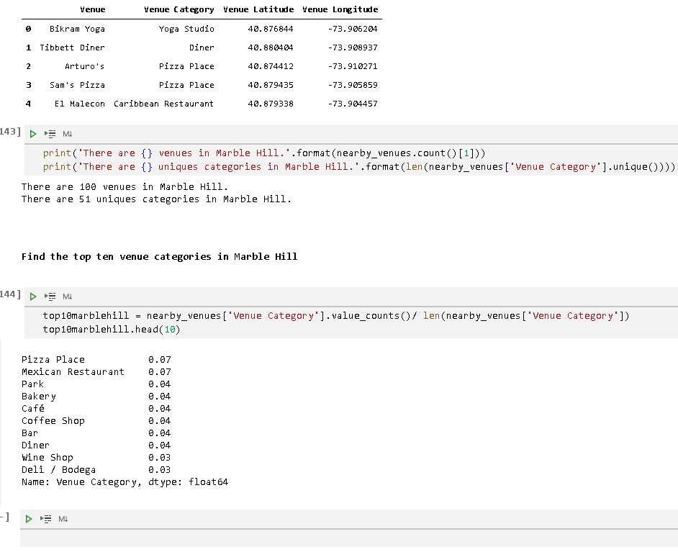
Results
There are 100 venues and 51 unique venue categories in Marble Hill.
Pizza place and Mexican Restaurant are the top two venue
Nearby venues dominated by food outlets of western style.

Slide 8
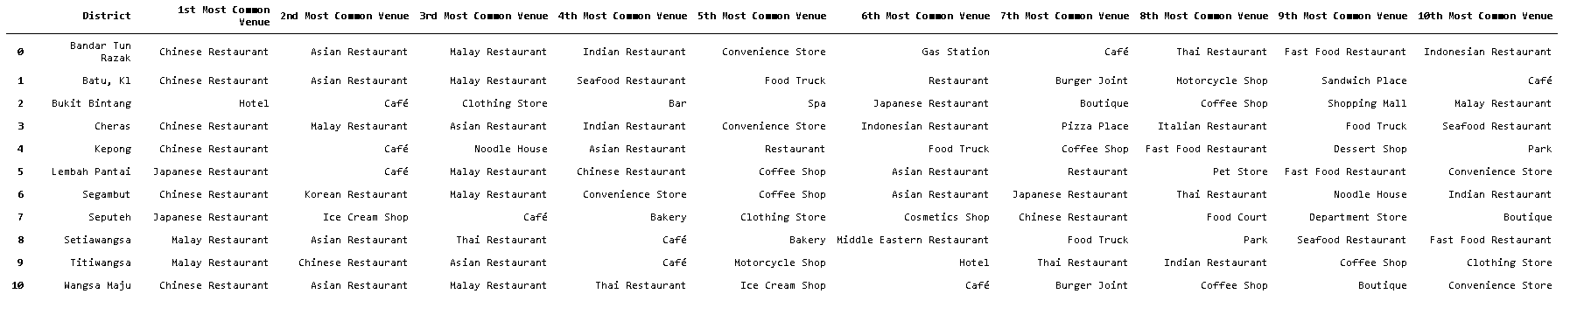
Results
11 districts in Kuala Lumpur
Total of 1040 venues with 188 different unique venues categories
Tope ten venue categories of each district in Kuala Lumpur

Slide 9
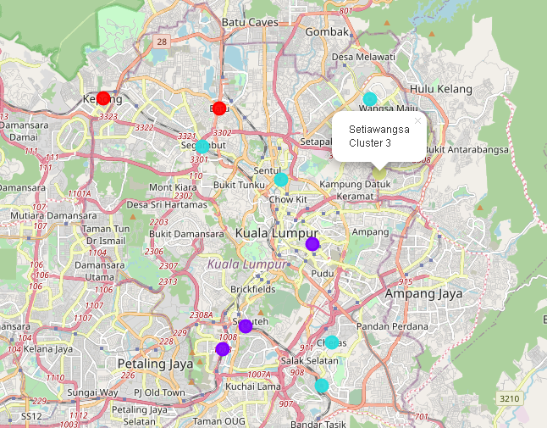
Discussion
Cluster 0:
Dominated by Chinese and Asian style food outlets
Cluster 1:
Less exposure to Malaysian style cuisine
Cluster 2:
Heavy influence by Malaysian style food outlet
Cluster 3
Dominated by Muslim and Asian style food outlets
The cluster of districts in Kuala Lumpur ( Cluster 0: Red, Cluster 1: Purple and Cluster 2: cyan and Cluster 3: light green)

Slide 10
Conclusion
Marble Hill is operating at a venue that that has a western influence
Districts in Cluster 1 have more exposure to international communities and tourists
Presence of hotels, cafés, coffee shops, shopping malls, and spas suggesting that the districts in this cluster 1 are more likely a tourist hot spot.
Hence, districts in Cluster 1 are more suitable for Marble Hill to open their second branch.
More analyses are required to identify the best district among the three districts listed in Cluster 1

Slide 11
Thank You

